Slide 1
Supported Employment
Easy Read Guide

Slide 2
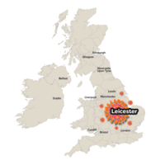
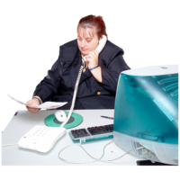
Who do we work with?
Living in Leicester
Over 18
People who want to find work.
People who have Autism, Learning Disabilities or both.

Slide 3
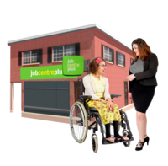
Who don’t we work with?
People who are on work programmes.
People already in work.
People in full time education

Slide 4
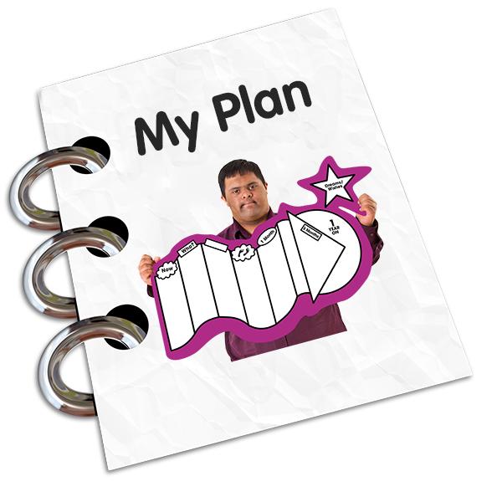
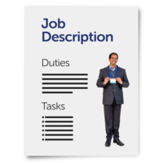
Help you prepare for work:
Look at how work might change your benefits
How you will get to work
Support with interviews
Look at jobs you would like. Help you apply for jobs.
Help you write a CV

Slide 5
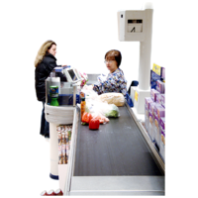
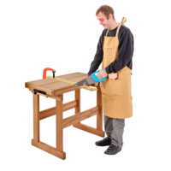
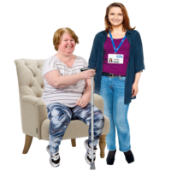
Help you find a job you would like to do.

Slide 6
Help you when you start work:

Slide 7
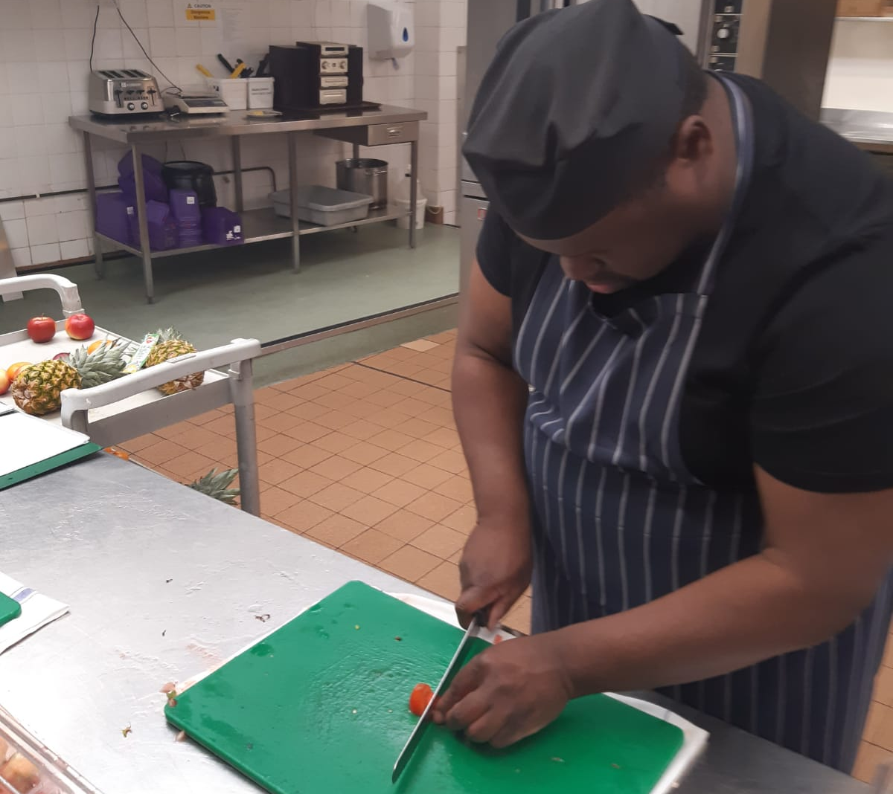
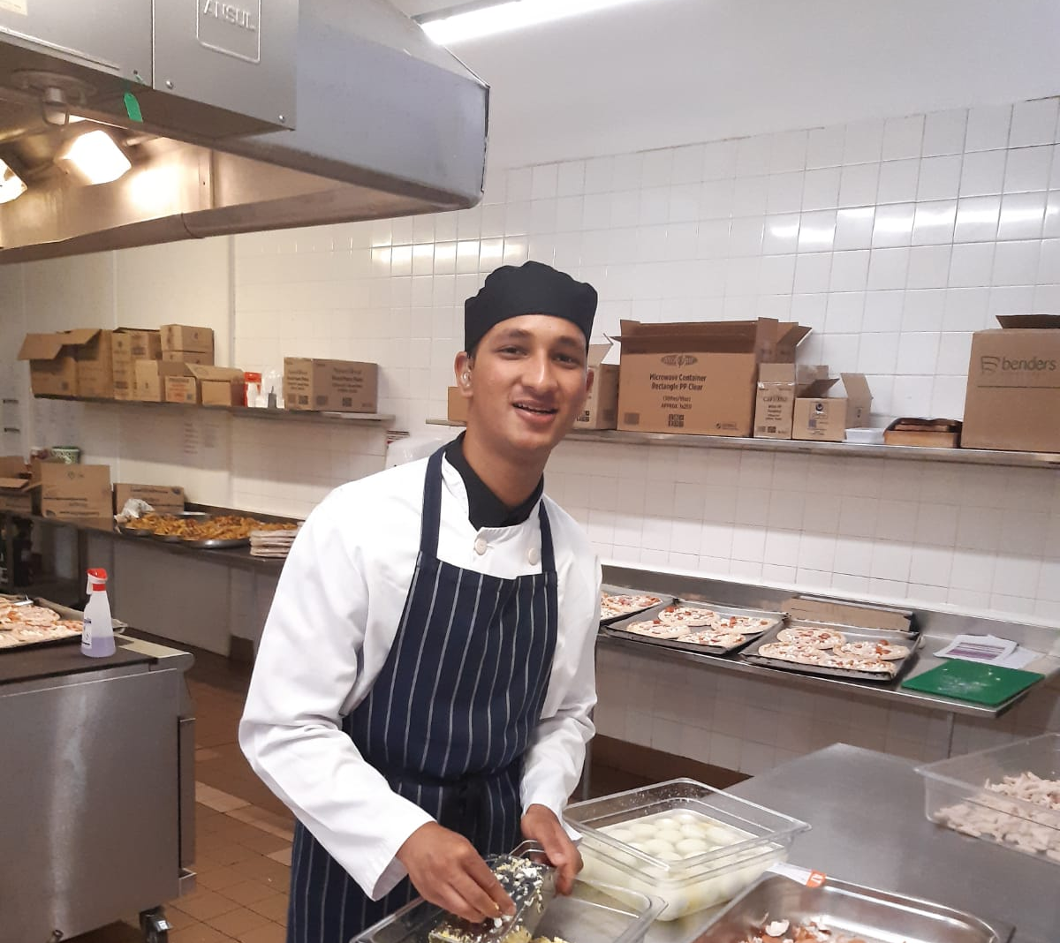
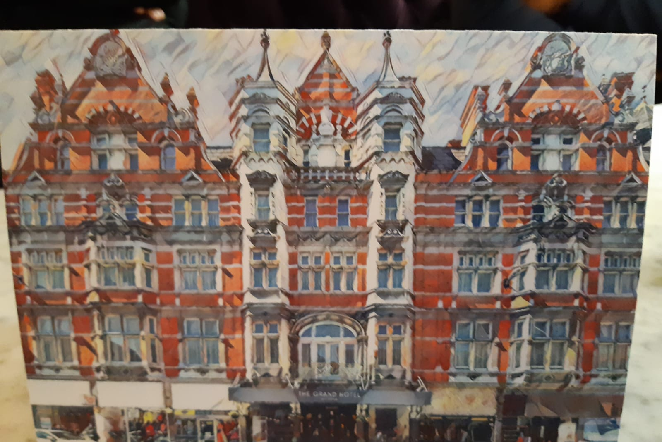
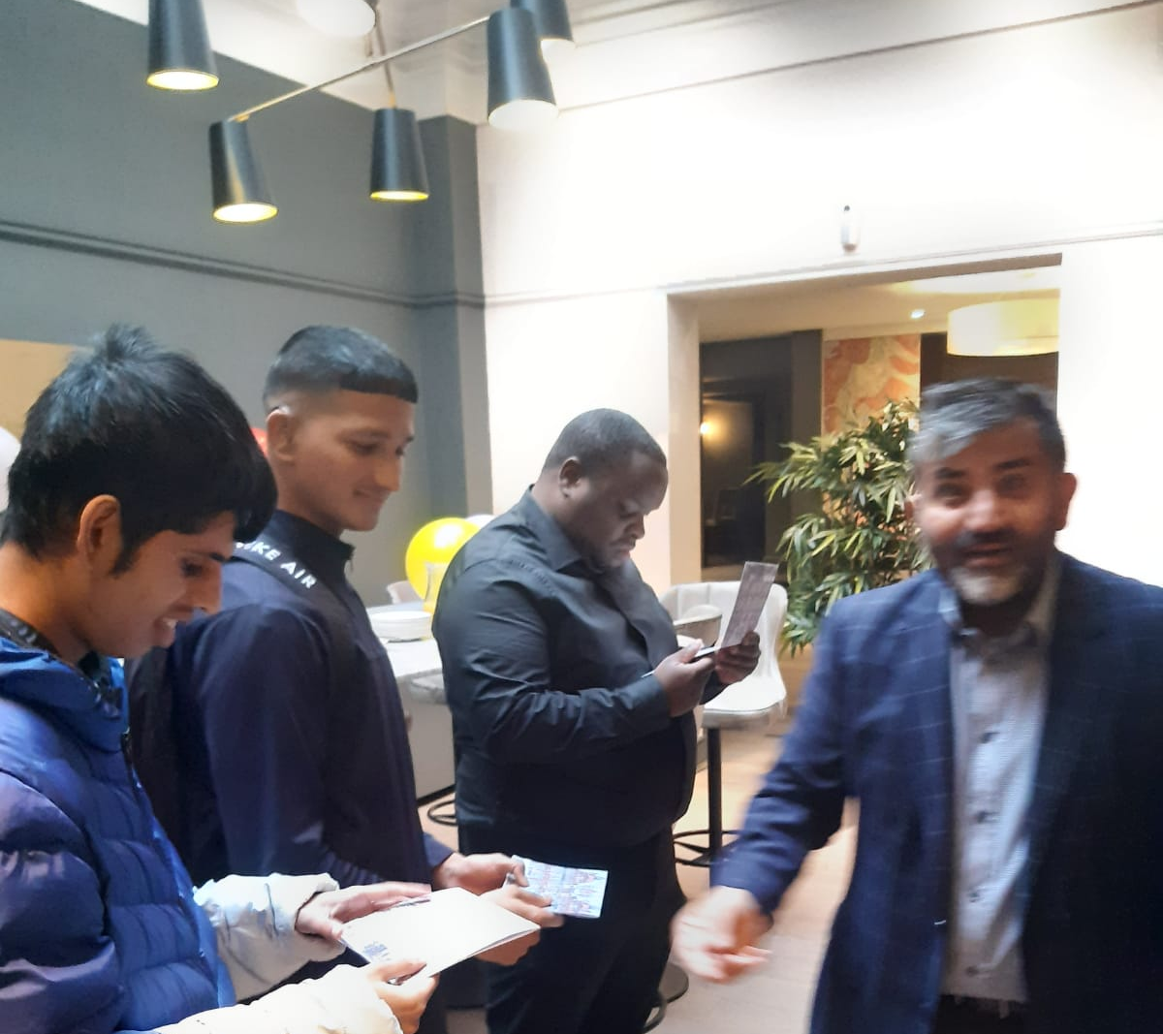
Working at the Grand Hotel
We worked with 3 people to find a job in Leicester: Dexter wanted to work in a kitchen, Jas wanted to work in a kitchen or Barista type work and Francis was eager to get any paid work.
We found an opportunity with the Grand Hotel, and we supported them together to look at a work trial instead of a traditional interview.
All three took part in work experience at the hotel trying kitchen work, conference and events set up and housekeeping.
After one session of work experience in each area they were all offered paid Employment.
They will rotate across each different area and work alongside a work buddy.
“I have a good time working with the team and getting tasks done”- Jas
Working at the Grand Hotel
Dexter
Francis
Jas- sharing his experience of work (please click above)
First Day

Slide 8
How can you contact or refer to Supported Employment?
You can refer using our website or you can get someone to help you. You can also ask your social worker to refer you.
https://www.leicesteremploymenthub.co.uk/job-seekers/supported-employment/
If you need help or more information you can email: supportedemployment@leicester.gov.uk
Or you can call: 0116 4540079

Slide 9
Any Questions?

